Slide 1

Coastal Navigation
tdgil.com
Piloting in the Modern World

Slide 3
Agenda
Friday
  Tools, Resources, and Navigation Aids
  Tides and Currents
  Latitude and Longitude
Saturday
  Dead Reckoning
  Piloting
Sunday
  Piloting Practice
  Test

Slide 4
Tools, Resources, and Navigation Aids

Slide 5
Navigation Tools

Slide 6
Essential Tools
Miscellaneous
  Pencils
  Erasers
  Calculator
  Watch
Plotting Tools
  Dividers/Compass
  Parallel rule
  Roller plotter
  Triangles

Slide 7
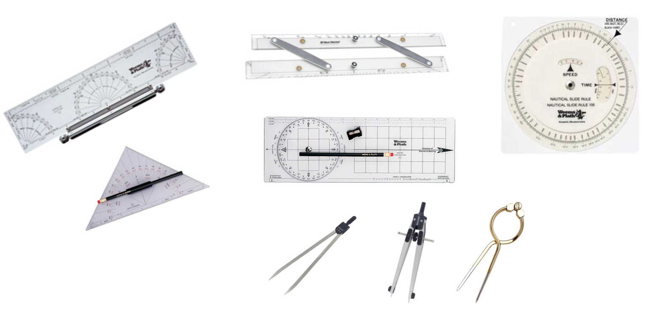
Plotting Tool Examples

Slide 8
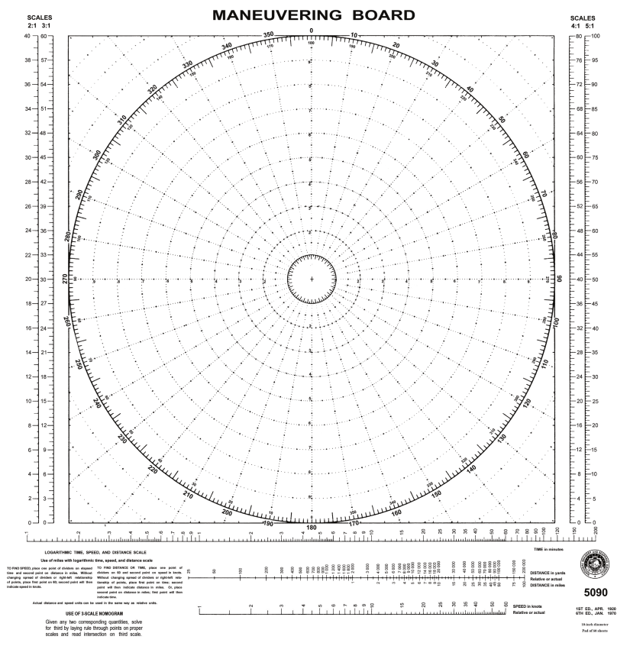
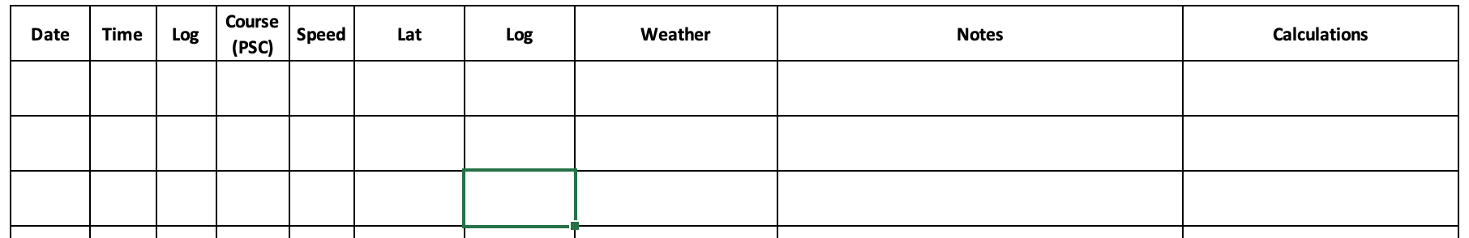
Essential Tools
Compasses
  Ships Compass
  Handheld Compasses
Navigation Logbook
Plotting Sheets
  Universal Plotting Sheet
  Maneuvering Board

Slide 9
Publications
Charts
  NOAA Charts
    Print on demand
    Raster Charts (look like paper charts)
    Electronic Navigation Charts (ENC) - Vector Charts
  Chart No. 1 (not really a chart)
Publications
  Coast Pilot
  Sailing Directions Enroute
  Notice to Mariners
  Local Notices to Mariners
  Light List
  List of Lights
  American Practical Navigator
Office of Coast Survey (NOAA) – https://nauticalcharts.noaa.gov/
USCG NAVIGATION CENTER – https://www.navcen.uscg.gov/
National Geospatial Agency – https://msi.nga.mil/

Slide 10
Which to Use When?
Local Notices to Mariners (LNM) vs. Notice to Mariners?
  LNM is the best source to update charts and identify hazards in a specific sailing area
  The Notice to Mariners covers the entire U.S.
    A great starting point if approaching U.S. waters from International Waters.
    May not have as much detail as the LNM
Light List vs. List of Lights?
  Light List identifies aids to navigation in U.S. waters.
  List of Lights identifies aids in other countries.
Coast Pilot vs. Sailing Directions Enroute?
  Coast Pilot is uses for U.S. waters
  Sailing Directions Enroute is used for navigation to and in other countries.

Slide 11
Navigation “Must Have” Publications
Chart(s) of Your Sailing Area
  When sailing in the ocean near San Francisco, I ALWAYS have 4 charts
    Entrance to San Francisco Bay (18649), Gulf of the Farallones (18645), Drakes Bay (18647), and Half Moon Bay (18682)
Chart No. 1 (this is a book, not a chart). It is OK to have it downloaded as a PDF file.
Coast Pilot (No. 7 around here) – I like to download it and print off applicable pages for study and notes.
Light List – downloaded.
Local Notices to Mariners – download it Thursday; STUDY IT!
Bonus “Must Have” – US Aids to Navigation System – Printed and waterproof

Slide 12
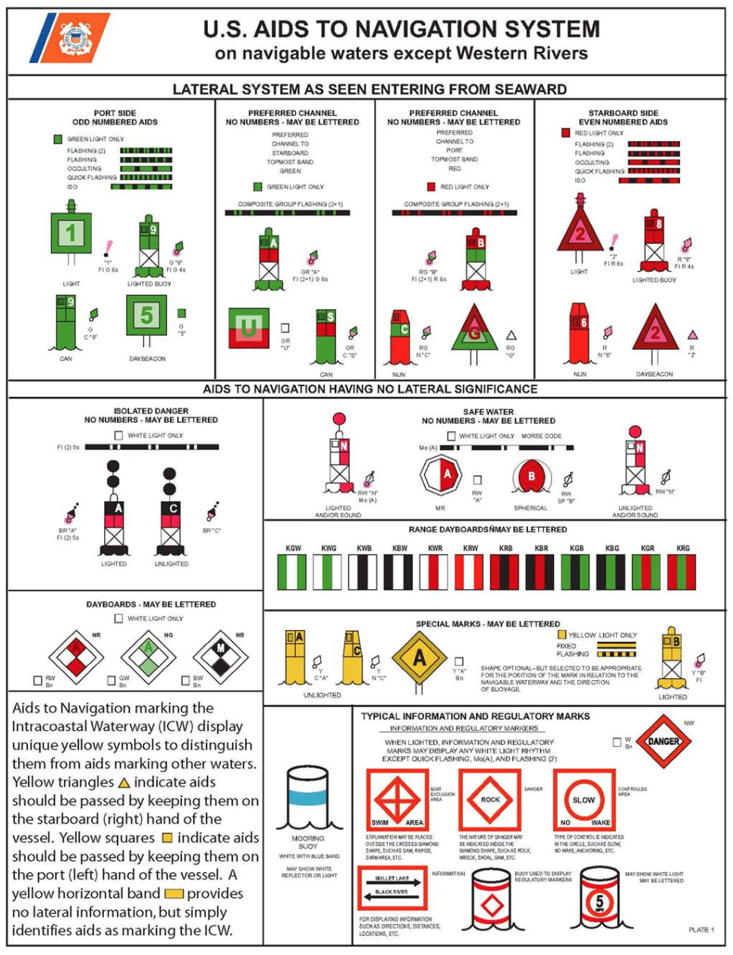
ATONs (Aids to Navigation)
Lateral Aids
Safe Water Marks
Regulatory Marks
Danger Marks
Definition
mark, n. 1. An artificial or natural object of easily recognizable shape or color, or both, situated in such a position that it may be identified on a chart. A fixed artificial navigation mark is often called a BEACON. This may be lighted or unlighted.

Slide 13
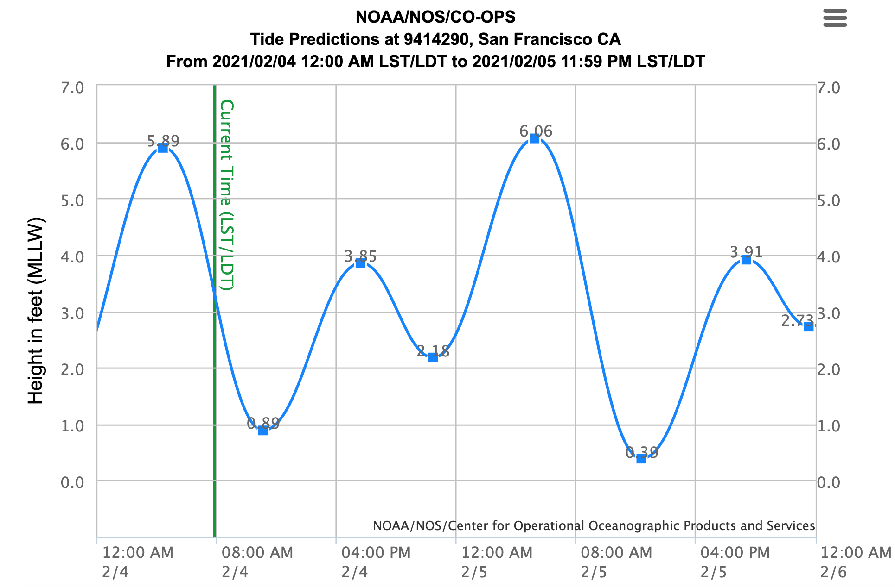
Tides and Currents

Slide 14
Finding Tide and Current Projections
NOAA Tide and Current Homepage
  https://tidesandcurrents.noaa.gov/
Tides
  https://tidesandcurrents.noaa.gov/tide_predictions.html
Currents
  https://tidesandcurrents.noaa.gov/noaacurrents/Regions

Slide 15
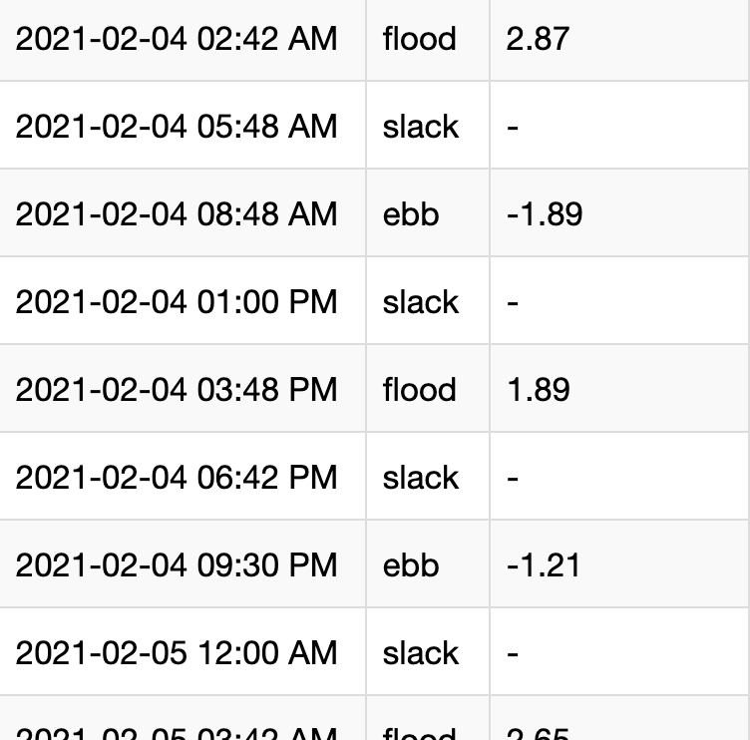
Currents

Slide 16
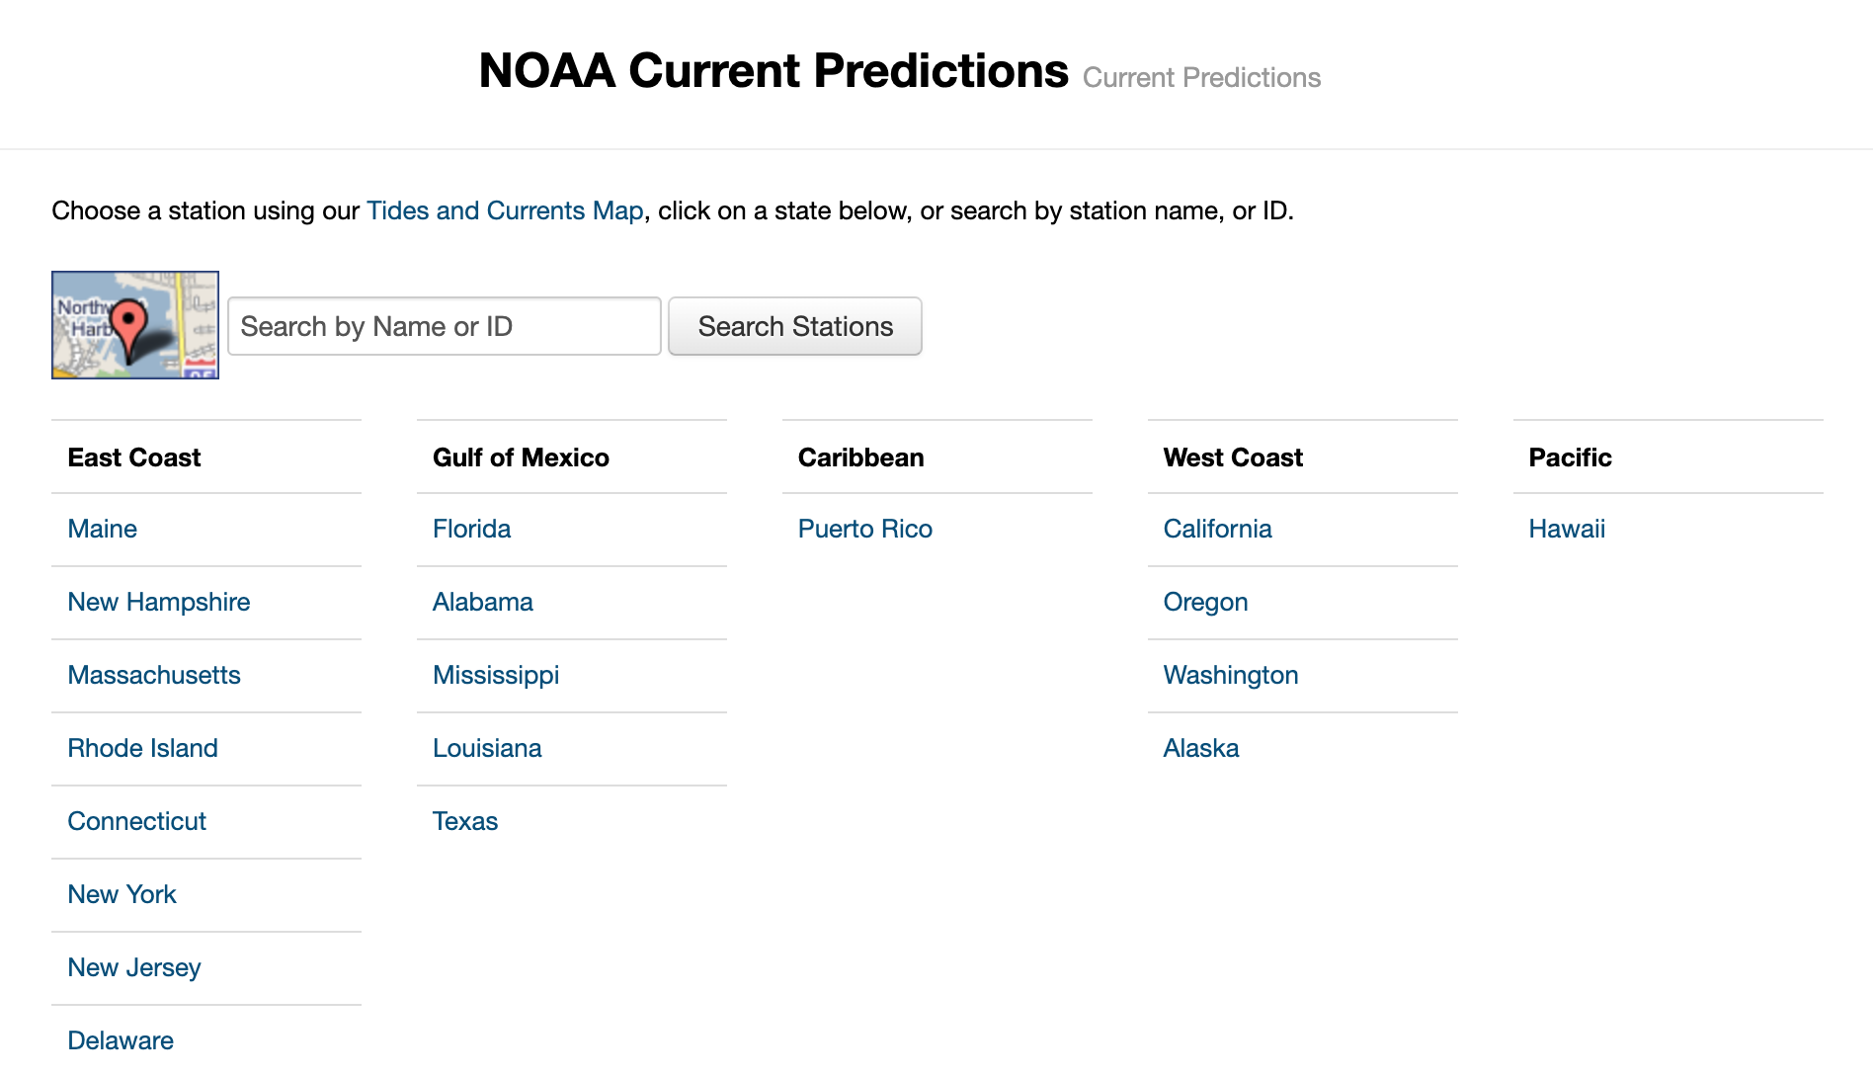
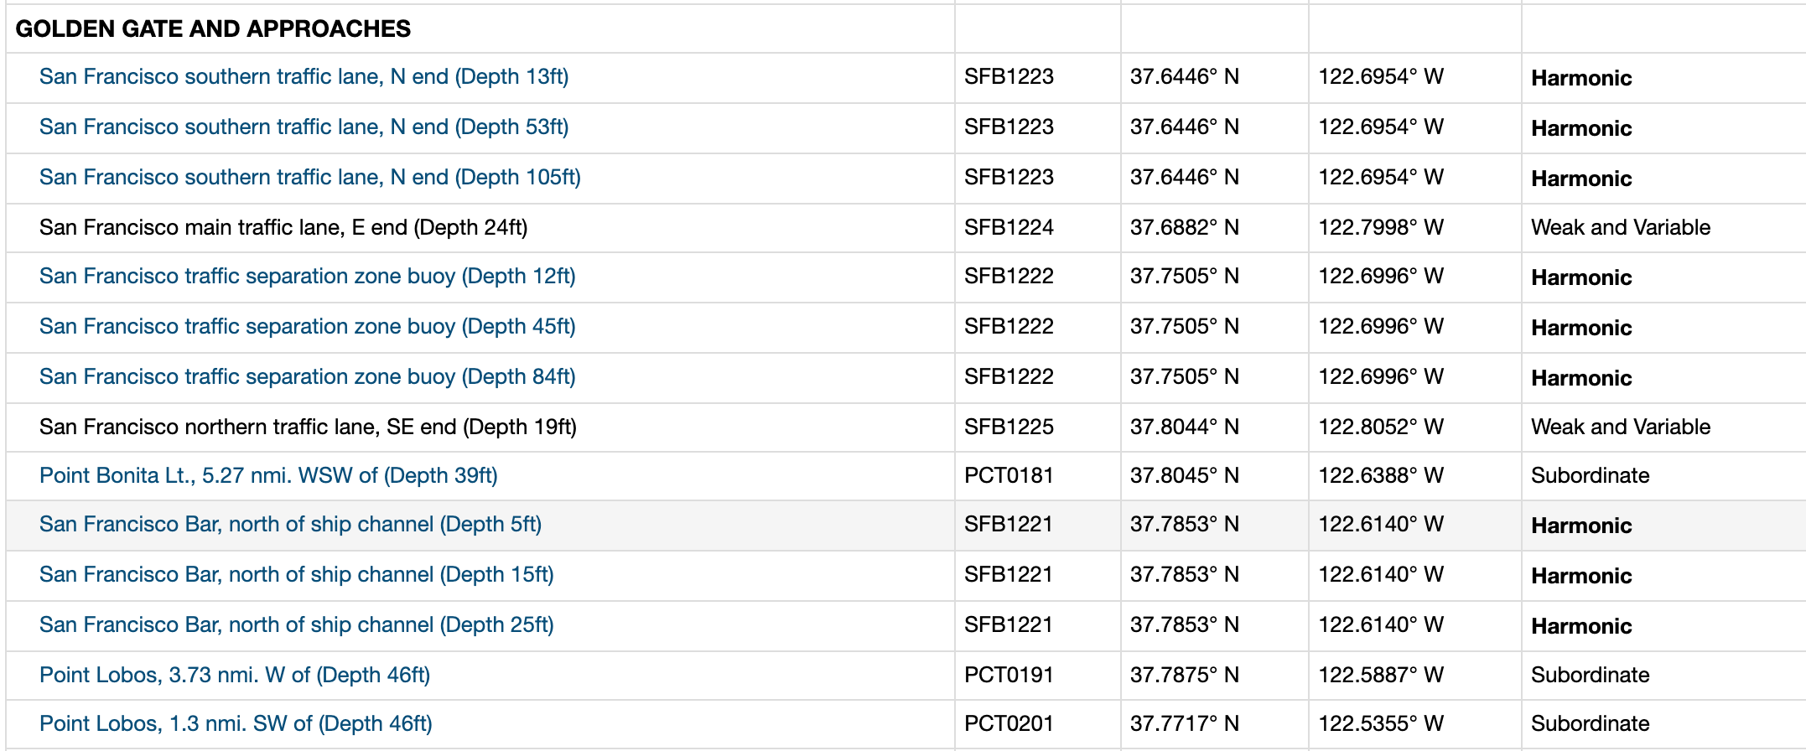
NOAA Currents Website
NOAA Currents – https://tidesandcurrents.noaa.gov/noaacurrents/Regions

Slide 17
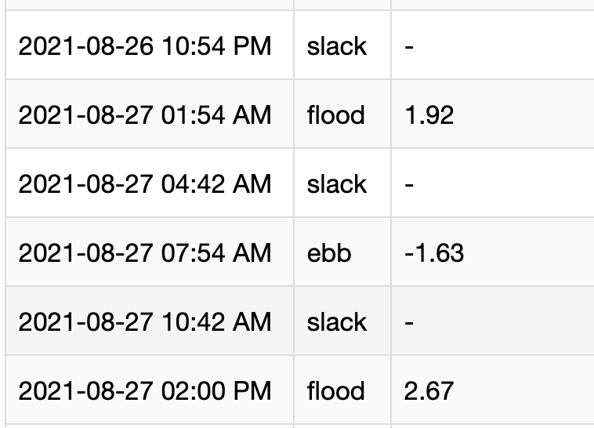
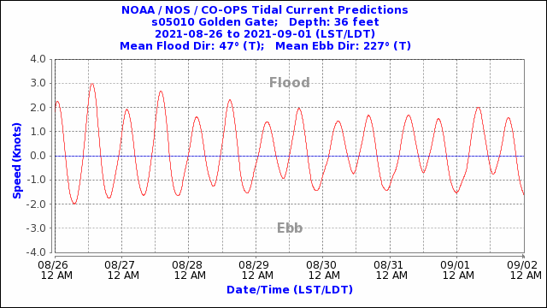
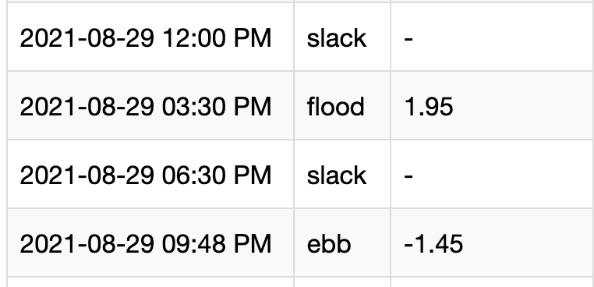
Advanced Coastal Cruising August 26-29, 2021

Slide 18
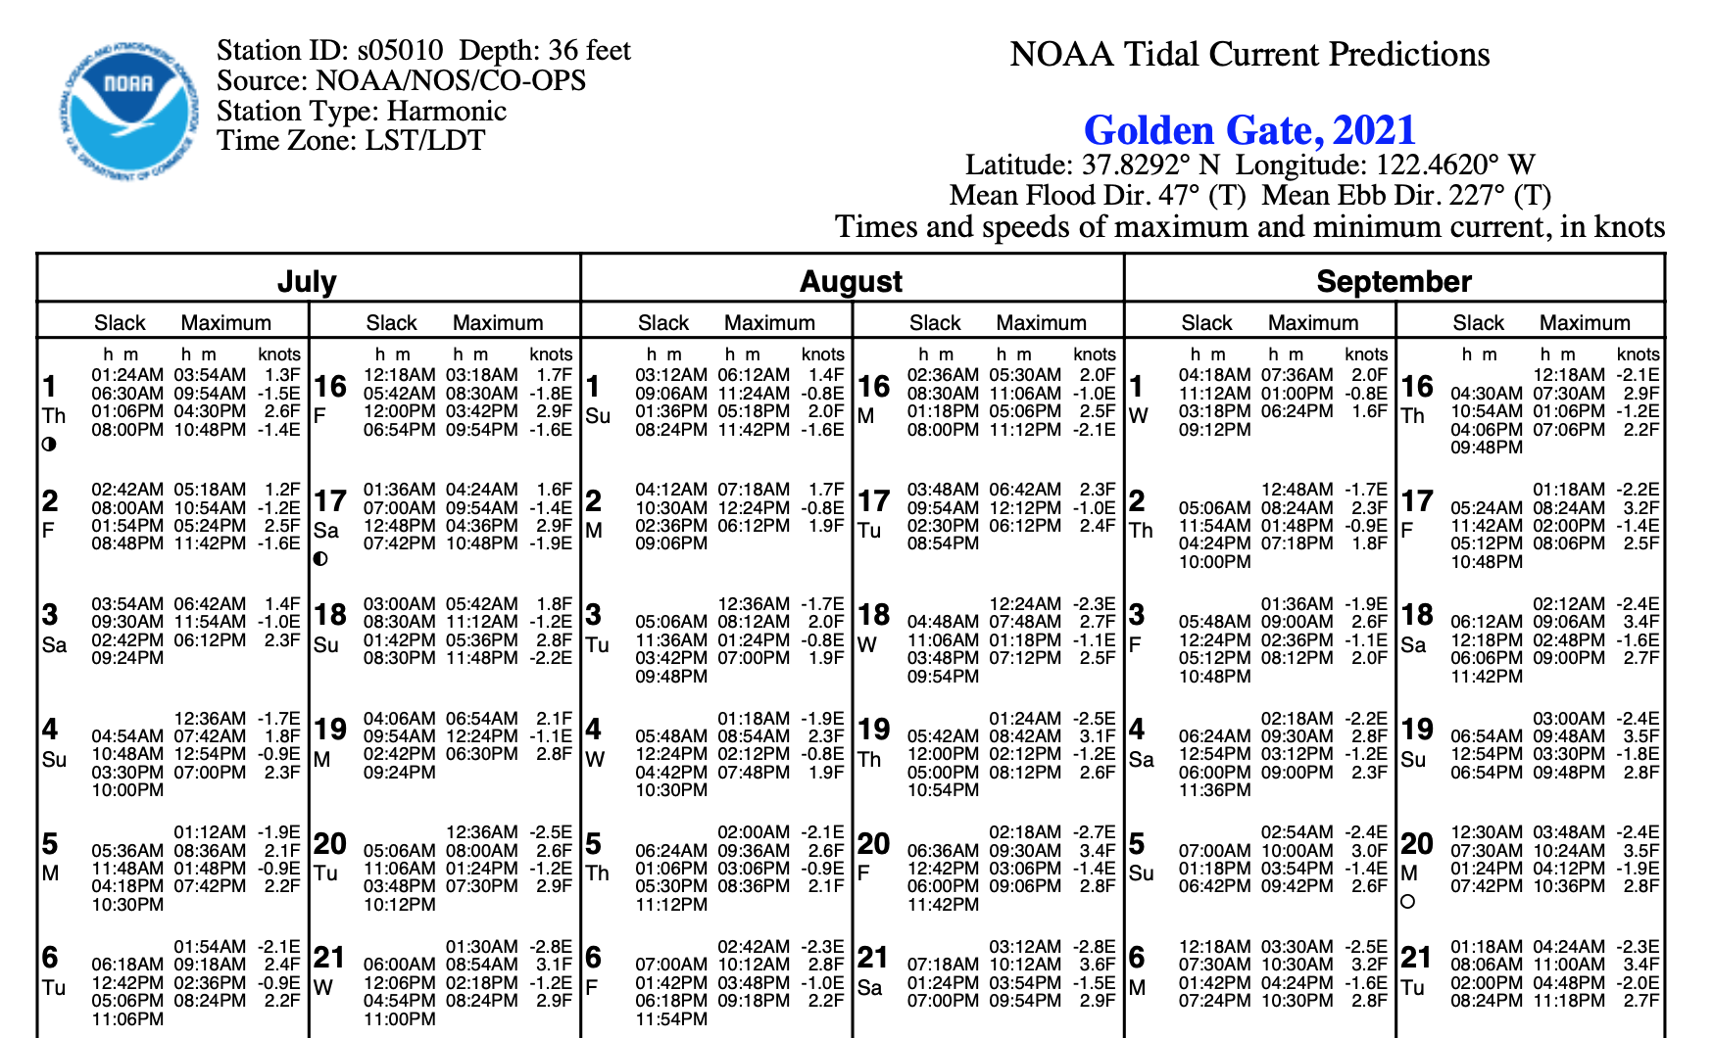
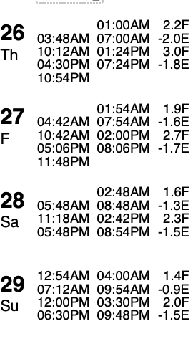

Slide 19
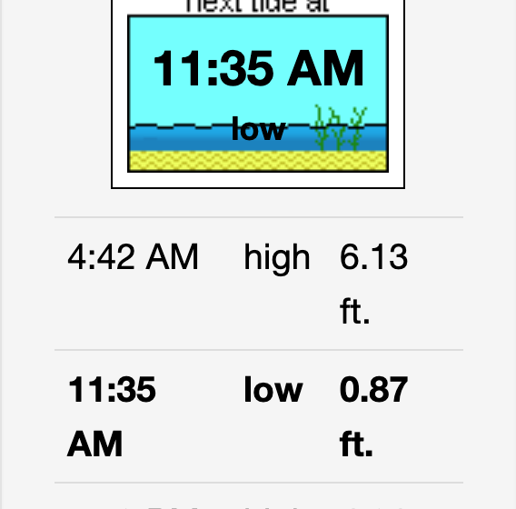
Tides

Slide 20
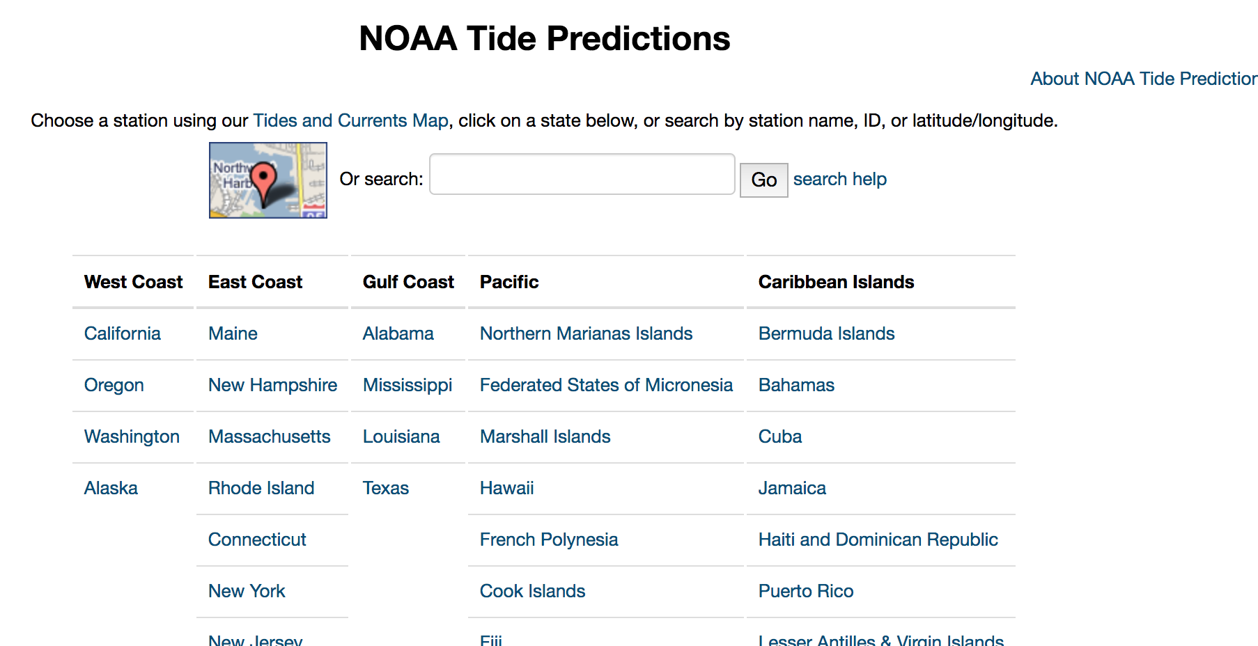
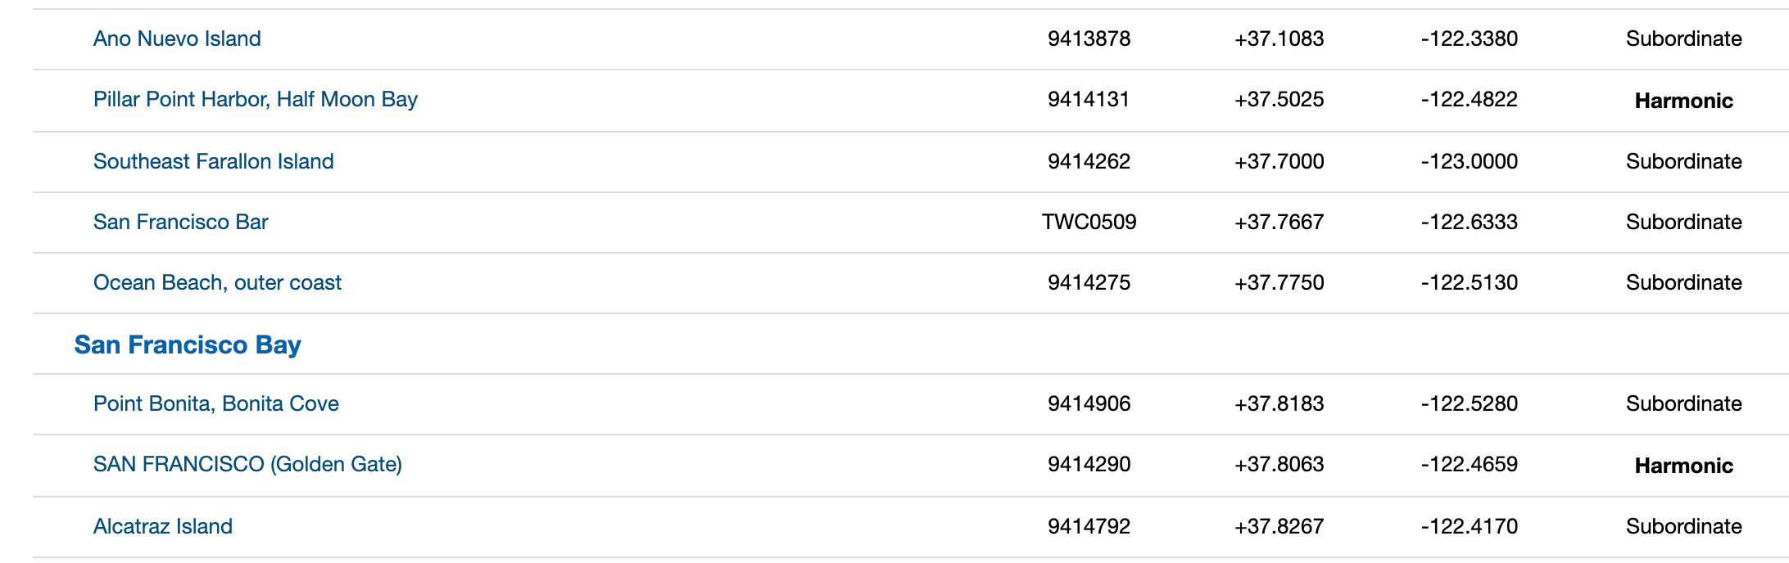
2020 Modern “Tide book”
https://tidesandcurrents.noaa.gov/tide_predictions.html

Slide 21
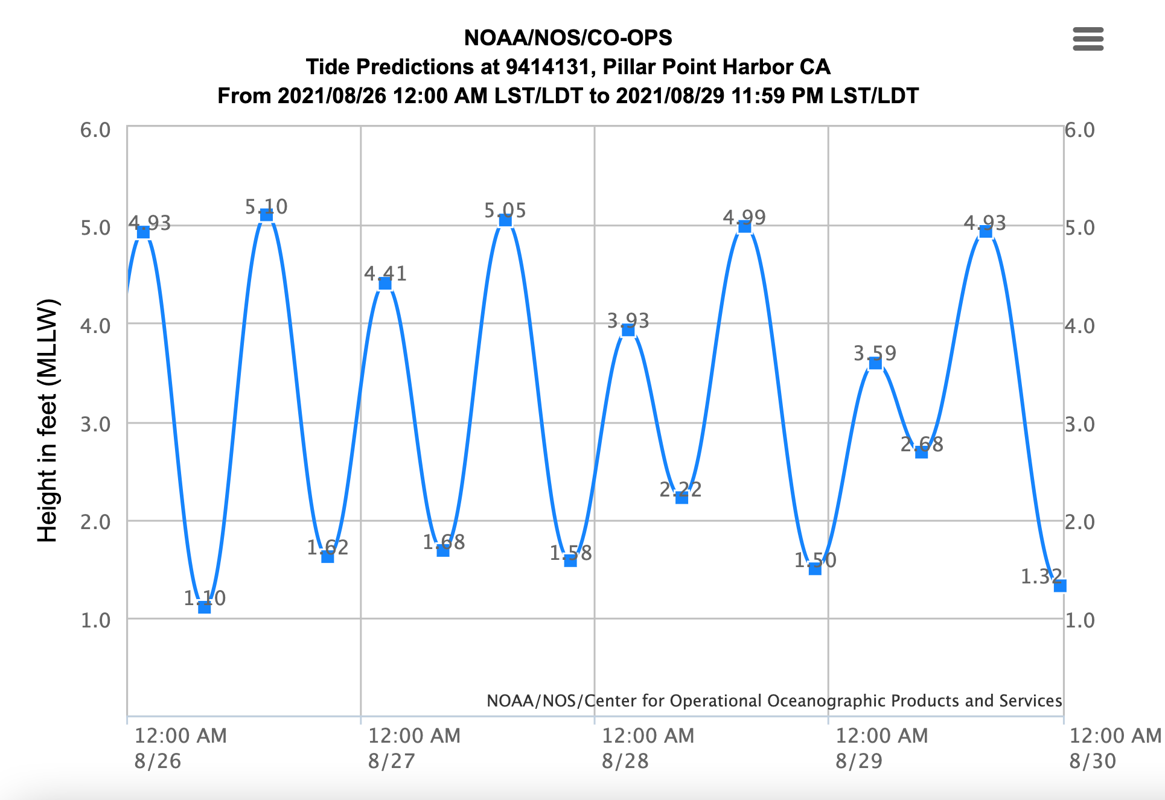
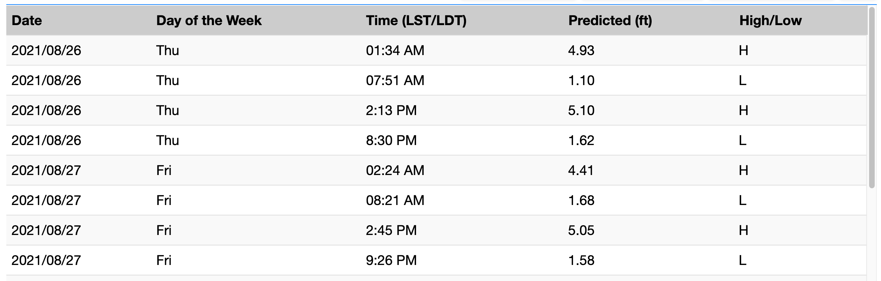

Slide 22
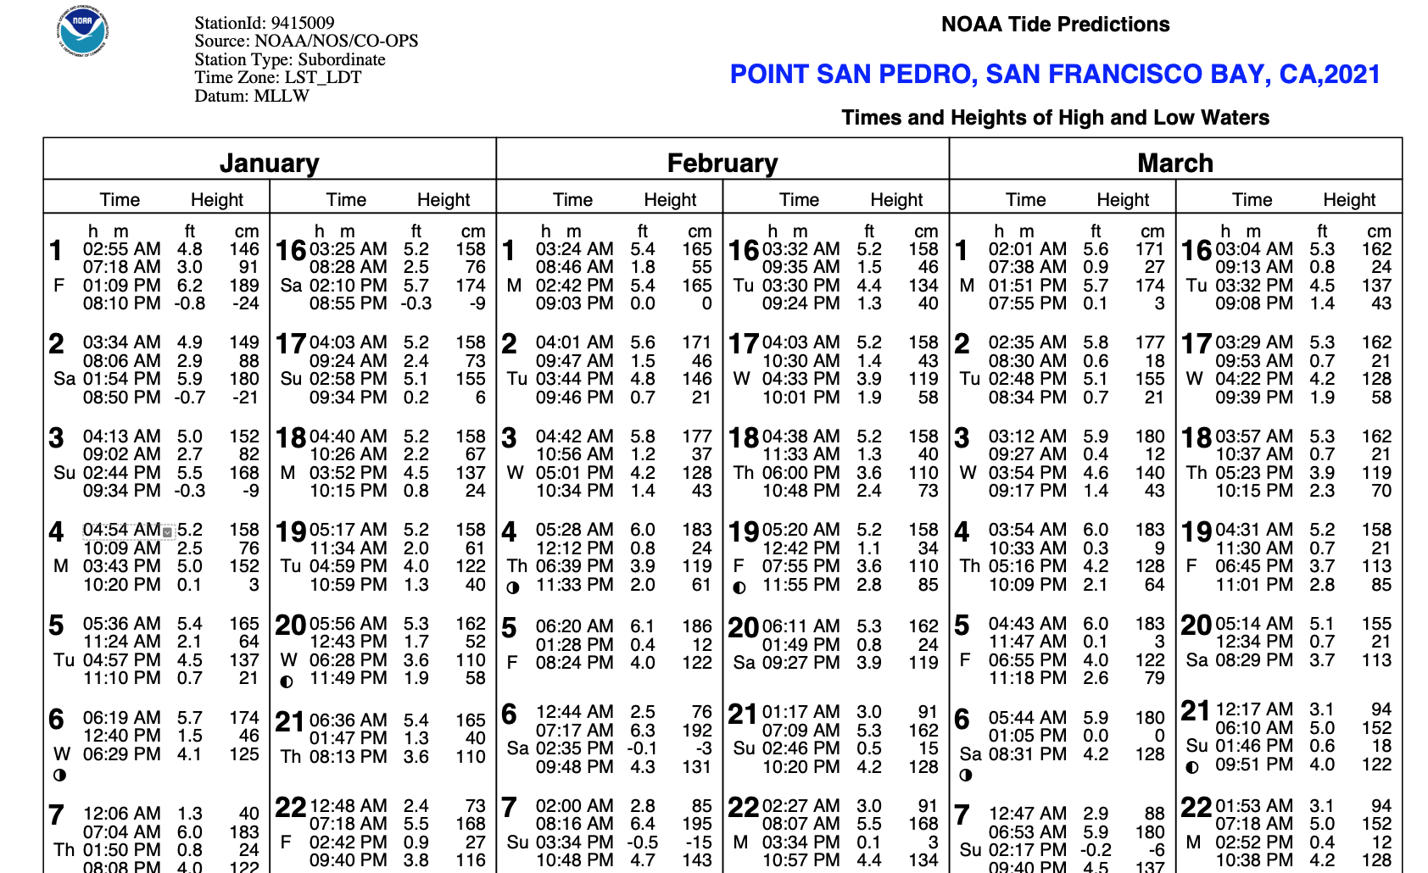
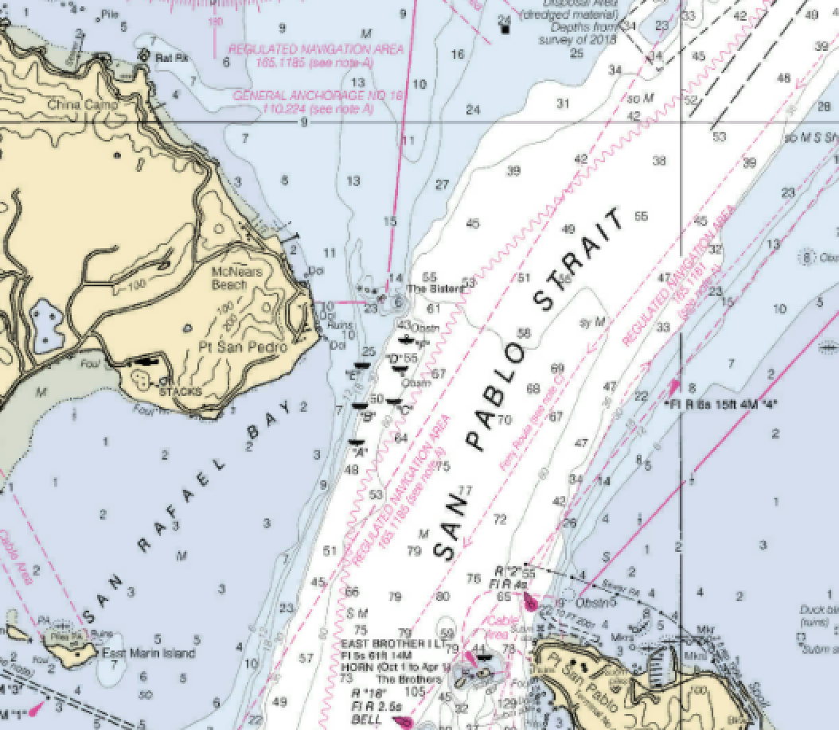

Slide 23
Rule of twelfths
Example … low tide of zero, high of 6’
1/12th of 6’ equals .5’
1 hour after low, tide would be .5’
2 hours after low, tide would be 1.5’
(.5 plus 1)
3 hours after low, tide 3’
(1.5 plus 1.5)
First hour 1/12th
Second hour … another … 2/12th
Third hour … another … 3/12th
Fourth hour … another … 3/12th
Fifth hour … another … 2/12th
Sixth hour … another … 1/12th

Slide 24
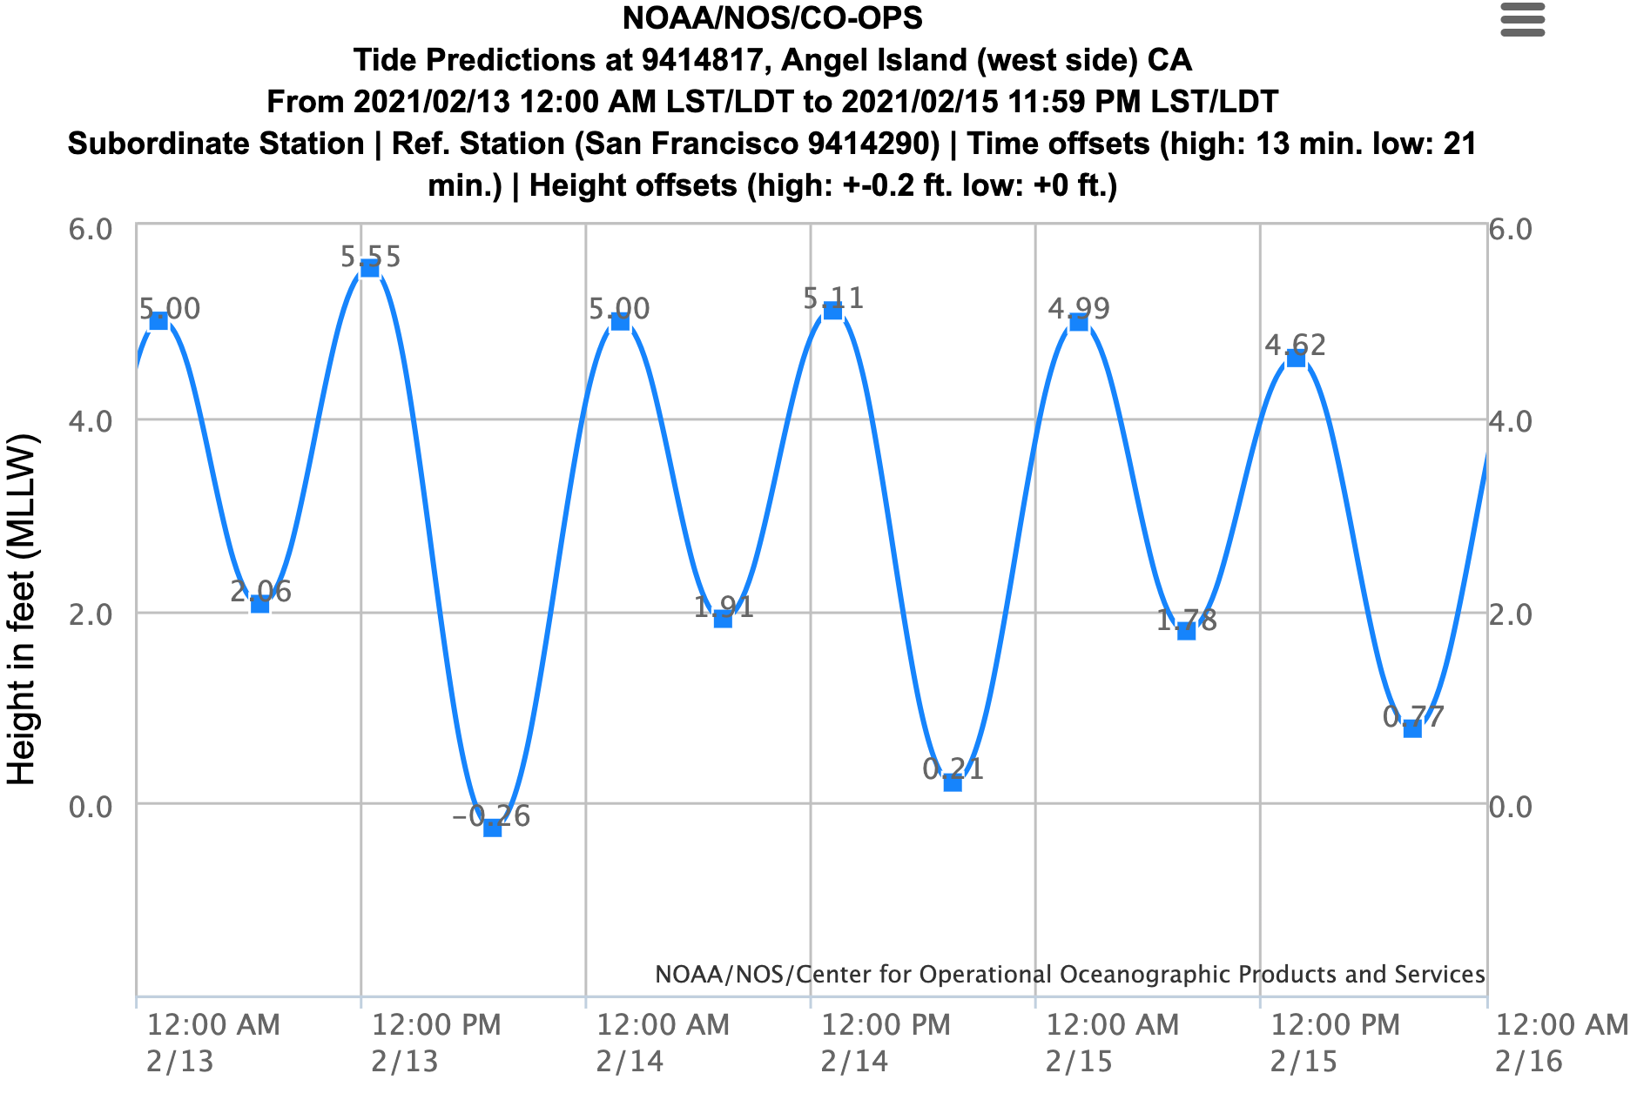
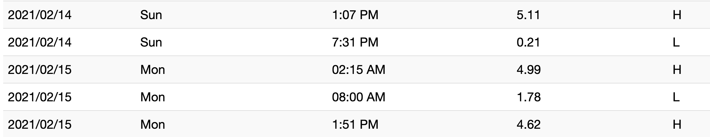
You plan to moor at Angel Island on Valentines Day. The depth of the mooring field is 4.5 feet at a zero tide. Your boat draws 6.5 feet.
What is the latest time (to the whole hour before) on Sunday you will have sufficient water to reach your mooring ball?
What time after 8:00AM Monday will you have enough water to leave the mooring field?

Slide 25
You plan to moor at Angel Island on Valentines Day. The depth of the mooring field is 4.5 feet at a zero tide. Your boat draws 6.5 feet.
5.1H - 0.21L = 4.89 tidal change / 12 = .4
5.1 – .4 = 4.7
1507 4.7 – .8 = 3.9
1607 3.9 – 1.2 = 2.7 Last chance to moor is 1600
1707 2.7 – 1.2 = 1.5
1807 1.5 – .8 = 0.7
1907 0.0 – .4 = 0.3
0800 4.6H - 1.8L = 2.8 tidal change / 12 = .2
0900 1.8 + .2 = 2.0
1000 2.0 + .4 = 2.4 May as well sleep in

Slide 26
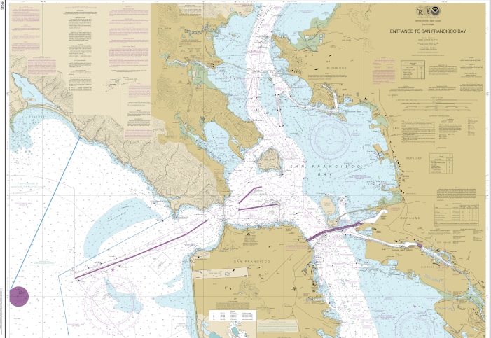
Latitude and Longitude

Slide 27
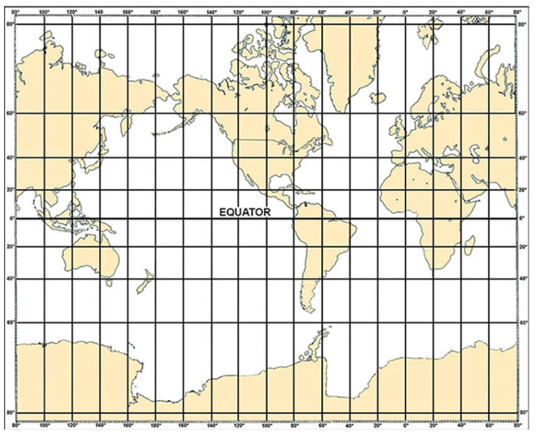
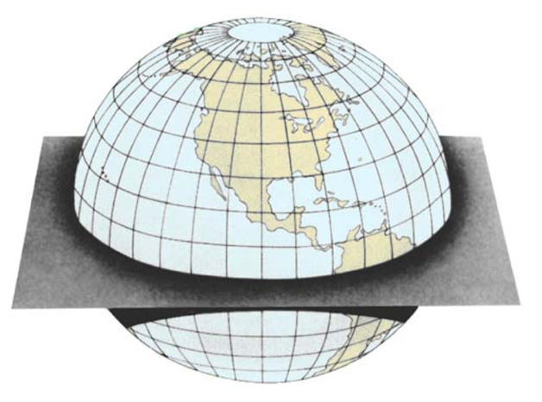
Projections
Prime Meridian
East
West
East
North
Equator
South
Mercator Projection

Slide 28
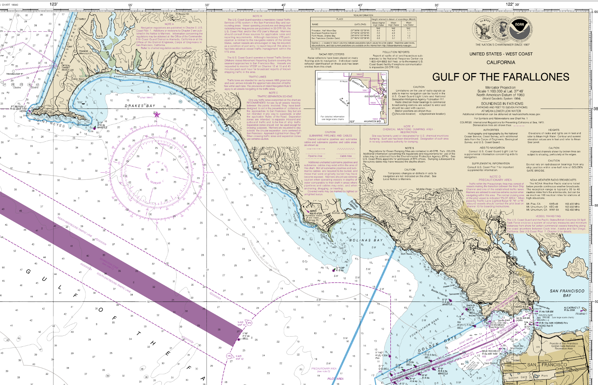

Slide 29
Practice Exercises – Finding Given Lat & Lon
Using the Gulf of the Farallones Chart excerpt
  What is the name of the object at 37° 51.6’ N; 122° 41.6W
  What is the name of the object at 38° 00.3’ N; 122° 58.0W
  What is found at 37° 56.7’ N; 122° 53.2W

Slide 30
Practice Exercises – Finding Given Lat & Lon
Using the Gulf of the Farallones Chart excerpt
  What is the name of the object at 37° 51.6’ N; 122° 41.6W
    G ”1DR” Fl G 6s
  What is the name of the object at 38° 00.3’ N; 122° 58.0W
    “CG”
  What is found at 37° 56.7’ N; 122° 53.2W
    Center of the compass rose

Slide 32
Practice Exercises – Finding Lat & Lon
Using the Coast Outline Chart Locate the Following Lat & Lon Locations
  37° 50.6’ N; 122° 35.5W (Label ”A”)
  37° 52.1’ N; 122° 52.5W (Label ”B”)
  38° 03.3’ N; 122° 46.4W (Label ”C”)

Slide 33
C
B
A

Slide 34
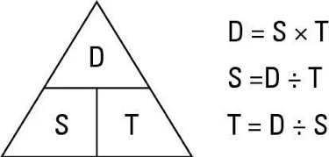
Distance Speed and Time

Slide 35
Practice Exercises – Finding Direction & Distance
Using the Coast Outline Chart Positions Just Plotted
  What is the distance from Point A to Point B
  What is the course from Point A to Point B
  What is the distance from Point B to Point C
  What is the course from Point B to Point C
  What is the distance from Point C to Point A
  What is the course from Point C to Point A

Slide 36
Practice Exercises – Finding Direction & Distance
Using the Coast Outline Chart Positions Just Plotted
  What is the distance from Point A to Point B
  What is the course from Point A to Point B
  What is the distance from Point B to Point C
  What is the course from Point B to Point C
  What is the distance from Point C to Point A
  What is the course from Point C to Point A
  13.5nm
  277T
  12.2nm
  023T
  15.3nm
  146T

Slide 37
C
C 023
D 12.2
C 146
D 15.3
C 277
D 13.5
B
A

Slide 38

Intro to Distance/Speed/Time Equations
⚓️ Distance/Speed = Time
⚓️ Distance/Time = Speed
⚓️ Speed X Time = Distance
6-Minute Rule - Distance traveled in 6 minutes multiplied by 10 = speed
6-Minute Rule #2 – 6 minutes is .1 hours … 12 minutes is .2 hours … etc.

Slide 39
Practice Exercises –
Determining Speed and Time
Using the Coast Outline Chart Courses and Distances Just Plotted (round to nearest tenth hour)
  At 4 knots how long to travel from A to B
  At 5.5 knots how long to travel from B to C
  At 6 knots how long to travel from C to A

Slide 40
Practice Exercises –
Determining Speed and Time
Using the Coast Outline Chart Courses and Distances Just Plotted (round to nearest tenth hour)
  At 4 knots how long to travel from A to B
  At 5.5 knots how long to travel from B to C
  At 6 knots how long to travel from C to A
  3.4 hours (3:24)
  2.2 hours (2:12)
  2.5 hours (2:30)

Slide 41
Adding and Subtracting Time
Always Use 24 Hour Time Notation (10:52PM is 2252)
Leaving Point A at 0852 at 4 knots what is the ETA at Point B?
You Arrive At Point B at 1205
What was your actual speed?
Continuing to Point C at 5.5 knots
what is your ETA?
The next morning, leaving Point C at 0950 at 6 knots, what is your ETA back at Point A?

Slide 42
Adding and Subtracting Time
Always Use 24 Hour Time Notation (10:52PM is 2252)
Leaving Point A at 0852 at 4 knots what is the ETA at Point B?
08 52
03 24
11 76
+1 - 60
12 16
You Arrive At Point A at 1205
What was your actual speed?
12 05
-08 52
3 13 = 3.2 hours
13.5nm/3.2 = 4.2kts
Continuing to Point C at 5.5 knots
what is your ETA? 1417
ETA at Point A is 12:20

Slide 43

Piloting

Slide 44
Dead Reckoning (DR)
Departure
Distance, Speed, and Time
Course vs Heading
Labels
6-Minute Rule - Distance traveled in 6 minutes multiplied by 10 equals speed
⚓️ Distance/Speed = Time
⚓️ Distance/Time = Speed
⚓️ Speed X Time = Distance
The only factors to be used in a DR plot are Course, Speed, and Time

Slide 45
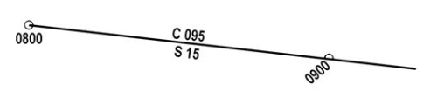
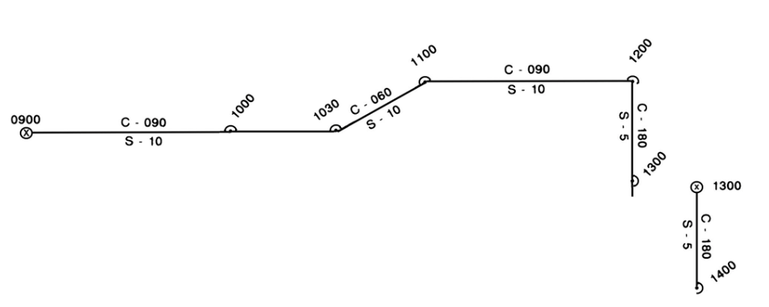
Dead Reckoning (DR)
Basic Labels
Course (C) on Top of Line Always in True
Speed (S) and/or Distance (D) Below Line
Time of Fixes Written Horizontally
DR Times Written Diagonally
Dot with Circle = Fix
Dot with Square = Estimated Position
Dot with Partial Circle = DR Position

Slide 46
Piloting
Lines of Position (LOP)
  Bearing to an object
  Line of Position by Range
  Depth Contour
Distance Off
  Angle off the bow
  Doubled Angle Fix
Fix
Running Fix
Estimated Position
Danger Bearings
  Constant bearing decreasing distance
  NMT/NLT
Piloting Definition: Navigation involving frequent or continuous determination of position relative to observed geographical points, to a high order of accuracy; directing the movements of a vessel near a coast by means of terrestrial reference points.

Slide 47
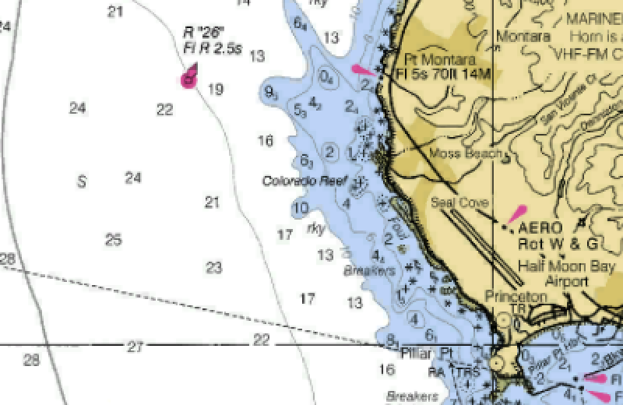
LOP by Bearing to an object
Bearing to Pt Montara Light
  067 True (053 Magnetic)
Bearing to Pillar Point Radar Dome
  115 True (101 Magnetic)
Two LOPs provide a
two-bearing fix
B 067
B 115

Slide 48
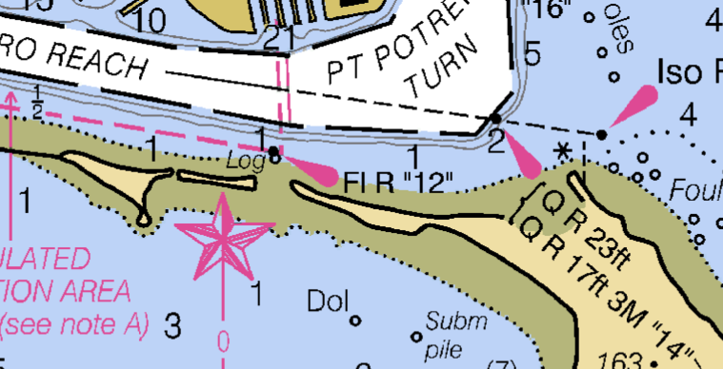
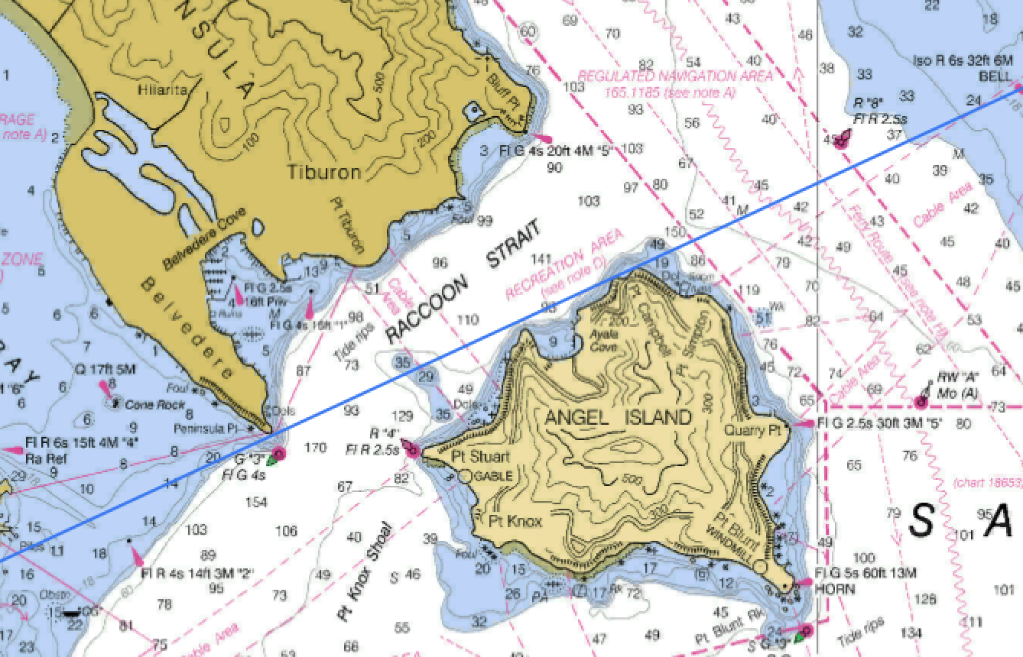
LOP by Range
A ”Range” is two objects in line
Point Campbell on Angel Island when lined up with Peninsula Point on Belvedere provides a line of Position by Range

Slide 49
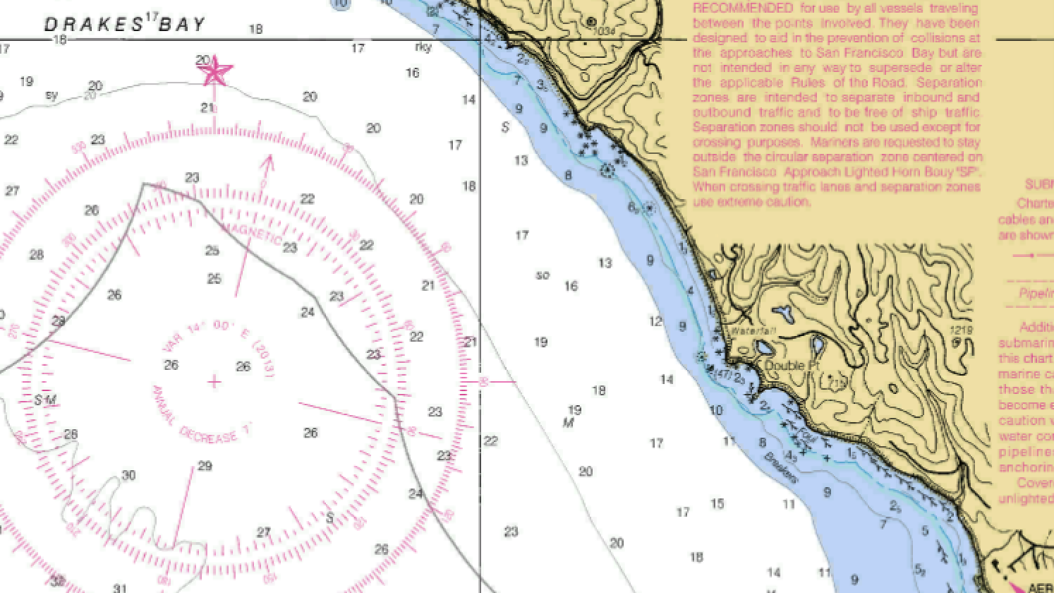
LOP by Depth Contour
The 20 Fathom contour running southeast from Drakes Bay makes a good LOP
Add a bearing to Double Point and you have a fix
B 090

Slide 50
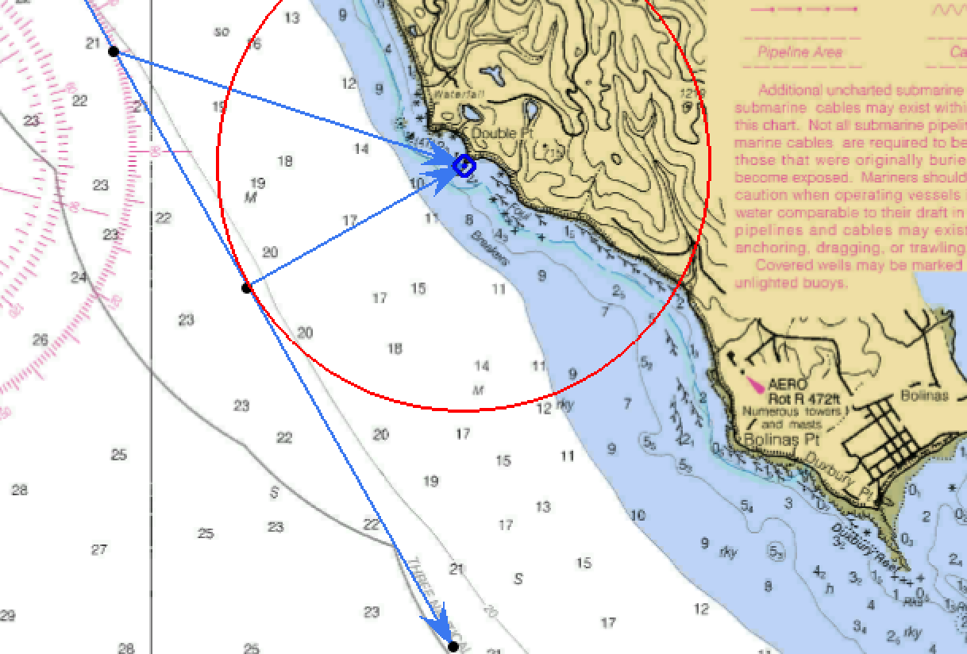
LOP by Distance Off (Double the Angle)
Two bearings of same object where second bearing is double the angle
on the bow of the first represents distance off at time of second bearing
A
Distance traveled from A to B is equal to the distance from B to the object, providing a circle of position
Add in the bearing to the object at position B and you have a fix
045 R
090 R
B

Slide 51
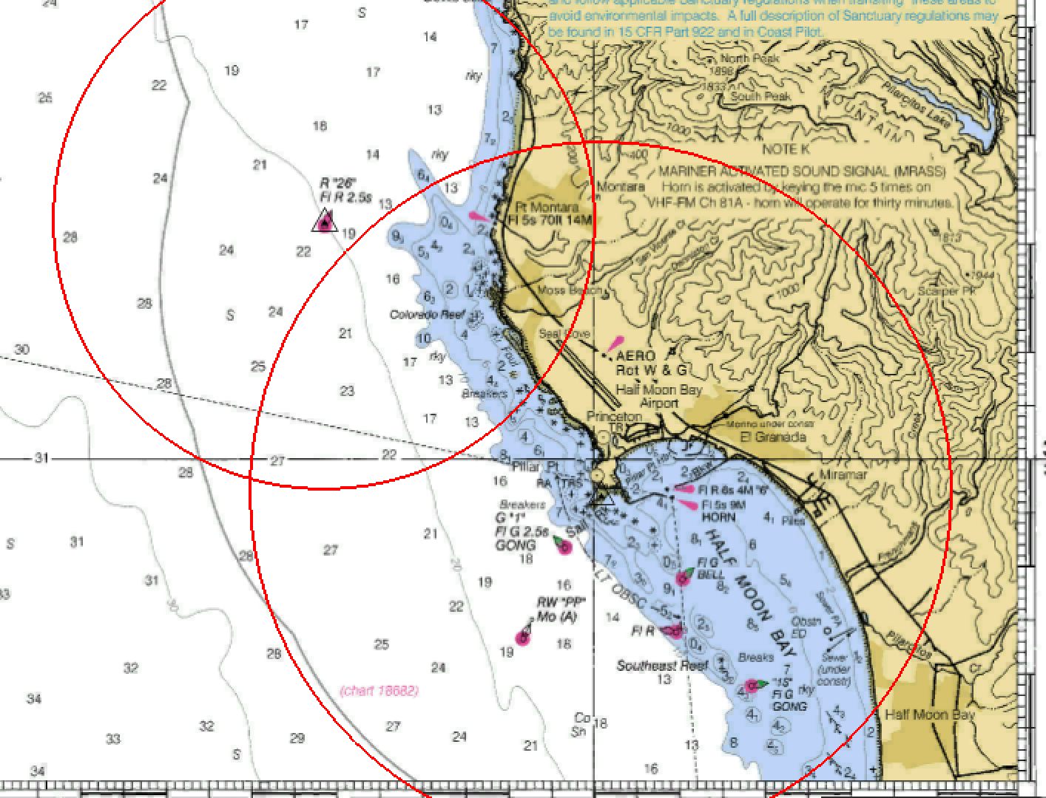
LOP by Distance Off (Radar Range)
Using the variable range marker (VRM) on a radar establishes a line of position around that object
Two radar ranges obtains two possible locations. Your DR or a third range provides a fix
One radar range plus any other lop provides a fix
2.5 nm
A
B
3.25 nm

Slide 52
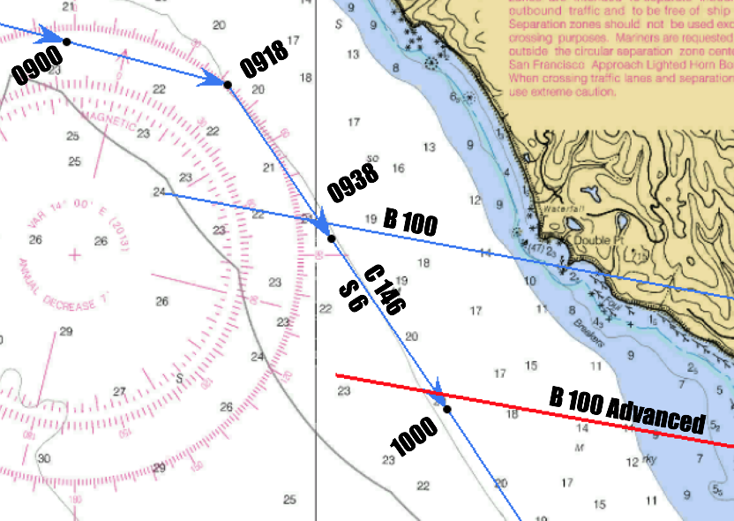
Running Fix (advancing a bearing)
A running fix is based on your DR plot
At 0938 a bearing is taken of the rock off the southern point of Double Point. The bearing is 100T
22 minutes later, at 1000, you have travelled 2.2 nm based on 6 kts, and plotted a new DR position.
Move (aka, advance) the 100T bearing line the distance traveled from 0938 to 1000. (Red line)

Slide 53
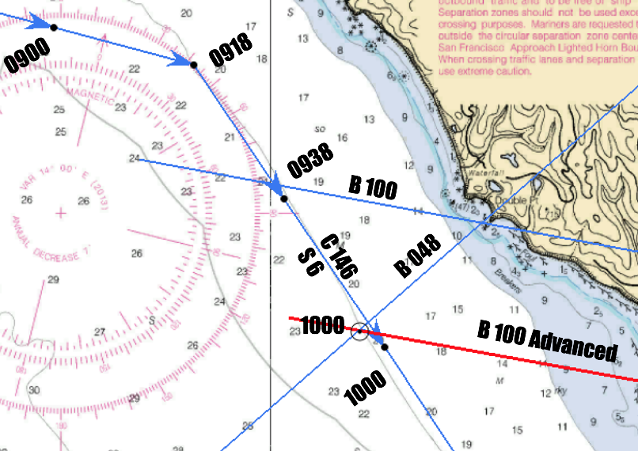
Running Fix (Same Target)
Once you have advanced your first bearing (lop)
Take and plot a second bearing to the same target. In this case, 048T
Your fix is the intersection of the new bearing and the advanced bearing

Slide 54
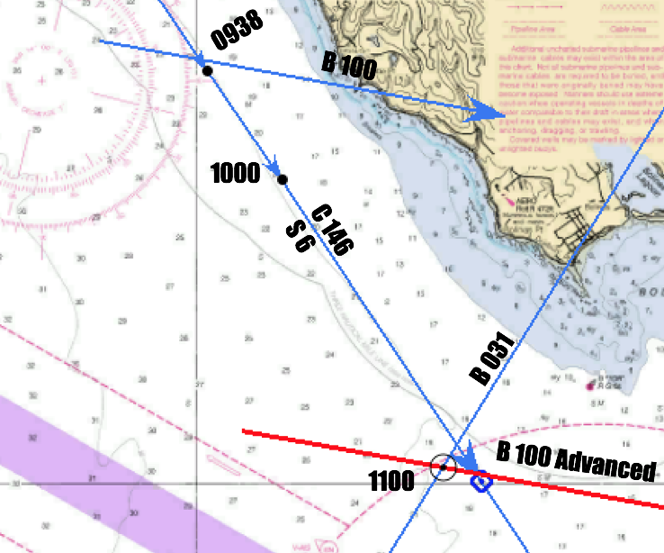
Running Fix (different target)
Running fix works with separate targets
Once you have advanced your first bearing (LOP)
Take and plot a second bearing to any other target. In this case 031T to Duxbury Point
Your fix is the intersection of the advanced LOP and the LOP to the new target

Slide 55
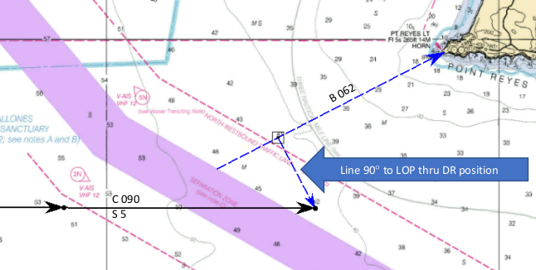
Estimated Position
An estimated position uses a DR plot plus one LOP
Draw a line perpendicular to the LOP that runs through the DR position
The estimated position is the point the LOP and the perpendicular line intersect
Estimated Position is not a fix. Do not reset the DR Plot

Slide 56
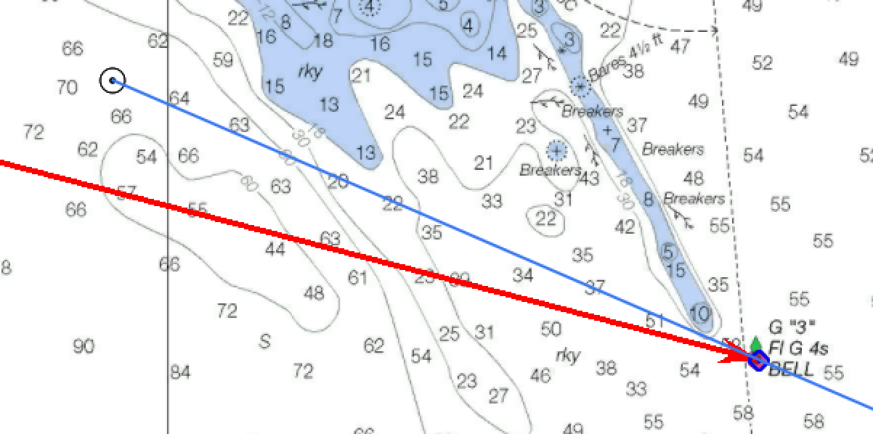

Danger bearing
Red line represents danger bearing drawn to the buoy to keep clear of the rocks
A bearing of the buoy should never read more(or less) than set danger bearing (NMT 091m)
Bearing to buoy of 099m puts you in the danger area
B 099M
NMT 091M
Why magnetic bearings?

Slide 57
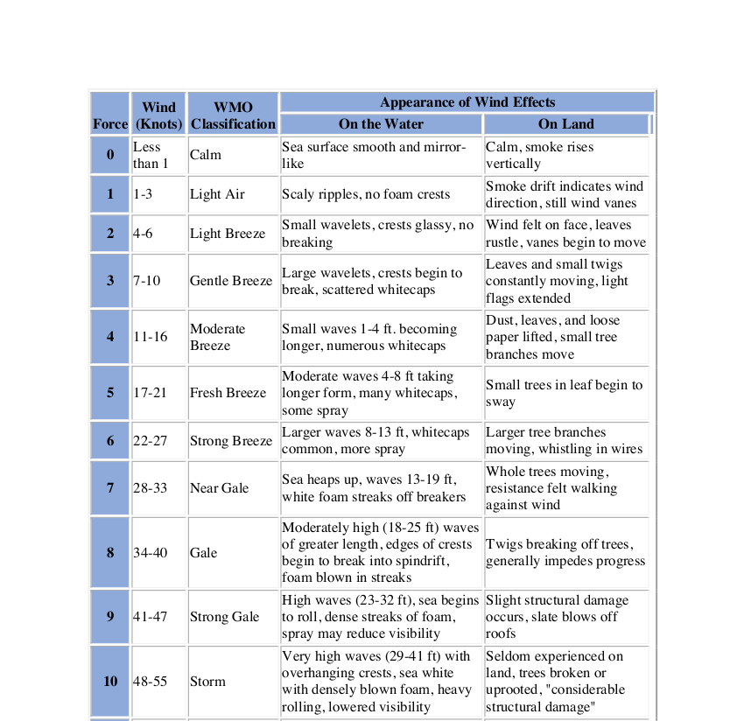
Effects of Wind, Currents and Tides
Leeway
Set
Drift
Tides
Tidal Currents

Slide 58
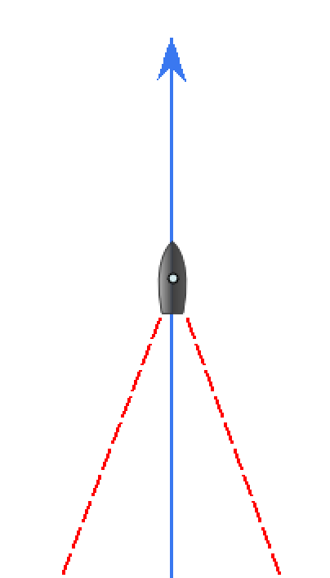
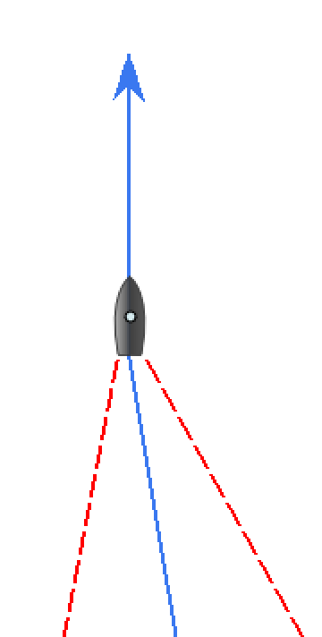
Estimating Leeway
Must be measured with no current present
If the center of your wake is the reciprocal of your heading, you have no leeway
Your wake should be approximately 39 ° from side to side (40 ° is close enough)
Find the reciprocal of your heading. In the examples that is 180 °
Take a bearing down one leg of your wake. If you use the starboard wake, add 20 ° to get the center of your wake. If you use the port wake, subtract 20 °
The difference between the reciprocal of your heading, and the centerline of your wake is your leeway.
In the left example, leeway is zero. In the right example, leeway is 10 ° to port. Your CMG in this case is 350 °
360 °
360 °
200°
160°
190°
150 °
180°
170 °

Slide 59
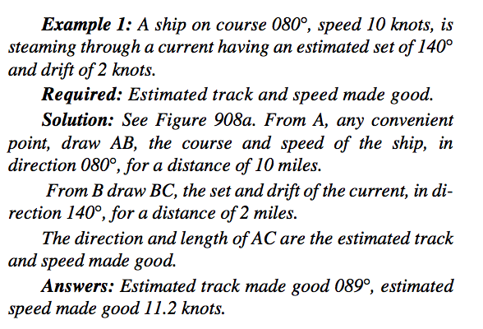
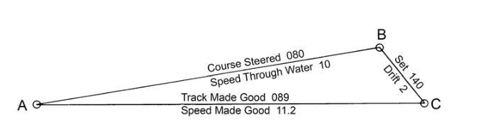
Finding Set and drift

Slide 60
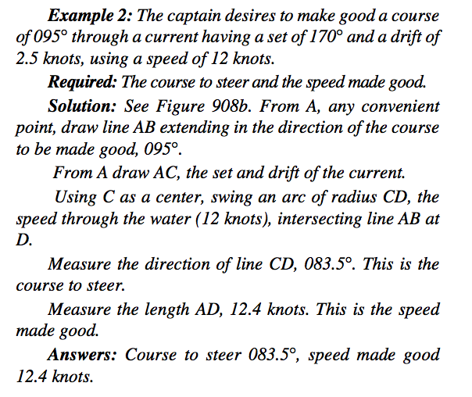
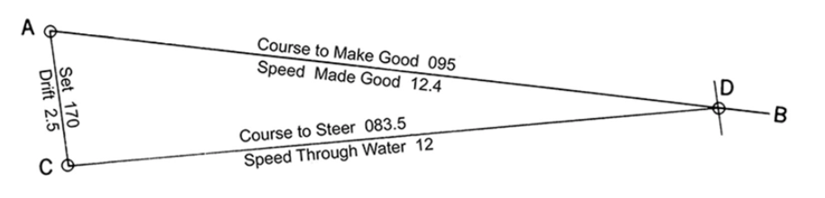
Course to steer

Slide 61
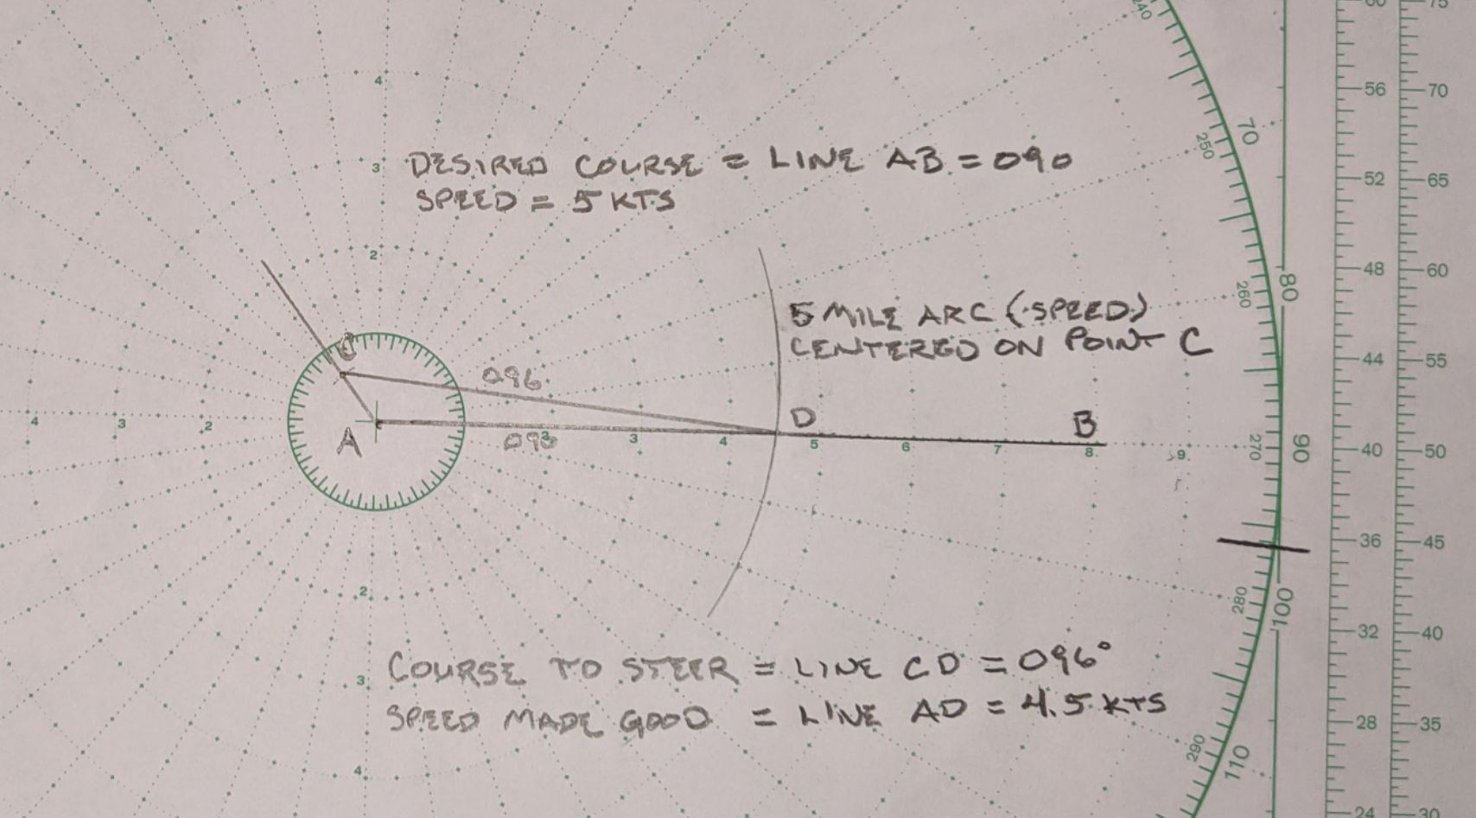

Slide 62
BW “SR” Mo(A) WHISTLE @ 41° 26.4’N; 71° 13.5’W
W Or “C” BELL @ 41° 19.7’N; 071° 24’W
You depart “SR” at 0915. Boat Speed 5 kts
Distance to “C”?
ETA at “C”
Course True and Magnetic?
Relative Bearing of Point Judith Light upon arrival at “C”

Slide 63
Continuing on the same course, at 1215, Block Island Southeast Light bears 224M and Point Judith Light bears 001M
What is your location?
Lat?
Lon?
What is your speed over ground.
What is the Set and Drift (hint: even though you have a fix, you need to find your DR position.

Slide 64
From G “1B1” Fl G 4 sec BELL @ 41° 15.5’N; 71° 34.5’ Plot a course of 050T.
Depart “1B1” at 1300 @ 5kts
At 1400 Point Judith Light bears 022M
At 1440 Point Judith Light bears 311M
Complete a running fix
What is your location?
Lat?
Lon?

Slide 65
At 0800, while underway at 5 kts, you are able to fix your location @ 41° 10.9 N; 071° 25.9’ W.
Plot a course to BW “WH” Mo (A) BELL @ 41° 29.4 N ; 071° 04.2 W
What is your course in True?
What is your ETA at WH?
At 0900 Point Judith Light bears 332M. Plot the bearing.
At 1000 Point Judith Light bears 293M.
What is your running fix location? Lat? Lon?
What is your CMG?
What is your SMG?
What is your Set?
What is your Drift?

Slide 66
What is your new course to WH?
What is your course in True to steer to compensate for set and drift?
What is your course to steer in magnetic?
What is your course to steer per ships compass (include deviation)?
What is your new ETA at WH?
According to LNM, the GR mark at Elisha Ledge (41° 26.7’ N; 071° 09.5’ W) is missing. Set up at danger bearing to leave Elisha Ledge to port using the tank at Acoaxel (41° 30.5’ N; 071° 05.7’ W) as your target.
What is the danger bearing?

